Slide 1

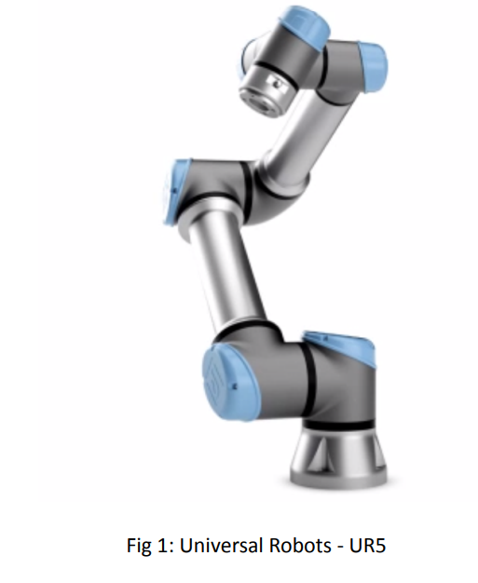
Project-2 ENPM – 662 Final Presentation
Team Members:
1) Tej Kiran: UID - 119197066
2) Dhinesh Rajasekaran: UID - 119400241
3) Arshad Shaik: UID - 118438832

Slide 2
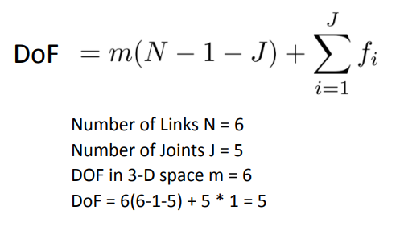
Project Description:
Introduction:
The main objective of the project is to implement an application based on basic pick and place operation using the Universal UR5 manipulator in the Robot Realization Laboratory.
Robot Type: Universal Robot’s UR5
DOFs and Dimensions:

Slide 3
Motivation for Project Selection:
The project selection is based on:
To understand and implement UR5 inverse kinematics
To gain knowledge on usage of MoveIt framework for pick & place application
To get practical knowledge on controlling UR5 hardware

Slide 4
Process followed to achieve the Goal
To understand the inverse position kinematics implementation of the manipulator:
Taken the official UR5 URDF file
Added controller
Added hardware interfaces
Written our own FK and IK algorithms based on D-H parameters
Implemented ‘Pick & Place’ workflow using the above functions and simulated the motion in Gazebo

Slide 5
Process followed to achieve the Goal
To gain knowledge on MoveIt framework:
Created a UR5 MoveIt package using MoveIt setup assistant
Used MoveIt Pick and Place API to move an abstract object in Rviz simulation environment
Created a sample MoveIt plug-in with our own IK algorithm
Loaded the plug-in into the MoveIt framework

Slide 6
DH-Table
Joint | d | alpha | a | theta
J1 | 0.089159 | pi/2 | 0 | Θ1
J2 | 0 | 0 | -0.425 | Θ2
J3 | 0 | 0 | -0.39225 | Θ3
J4 | 0.10915 | pi/2 | 0 | Θ4
J5 | 0.09465 | -pi/2 | 0 | Θ5
J6 | 0.0823 | 0 | 0 | θ6

Slide 7
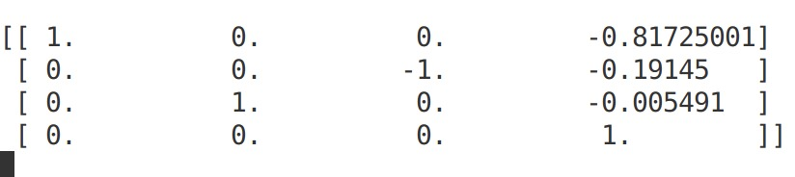
Forward Kinematics
End effector configuration for UR5 home location:
Table:
Figure: next slide

Slide 8
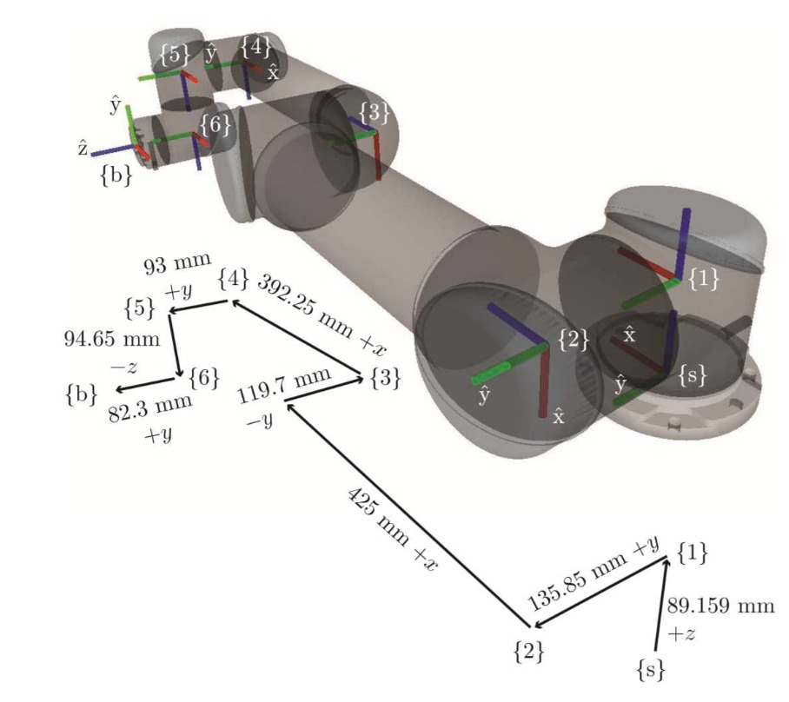
Forward Kinematics Validation
The co-ordinates of the end frame match
with the figure shown here
Ref: http://dr-kors.at/pdf/Dynamic_parameter_identification_of_the_Universal_Robots_UR5.pdf

Slide 9
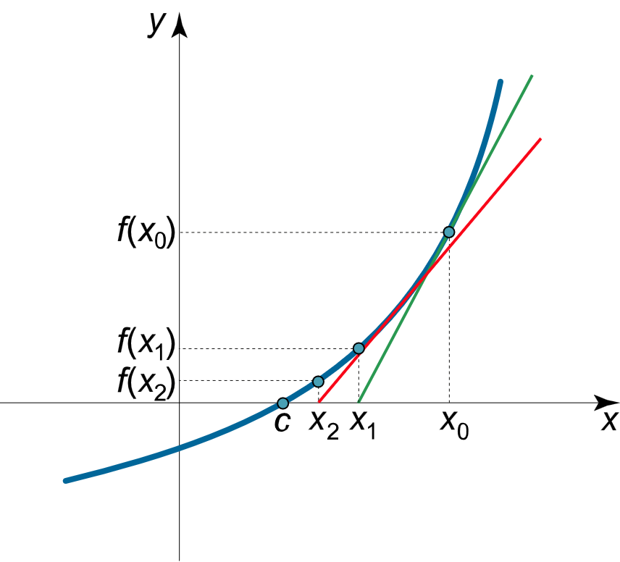
Inverse Kinematics
Newton – Raphson Method:
Error
Joint Angles

Slide 10
Inverse Kinematics Validation
No. of Iterations:

Slide 11
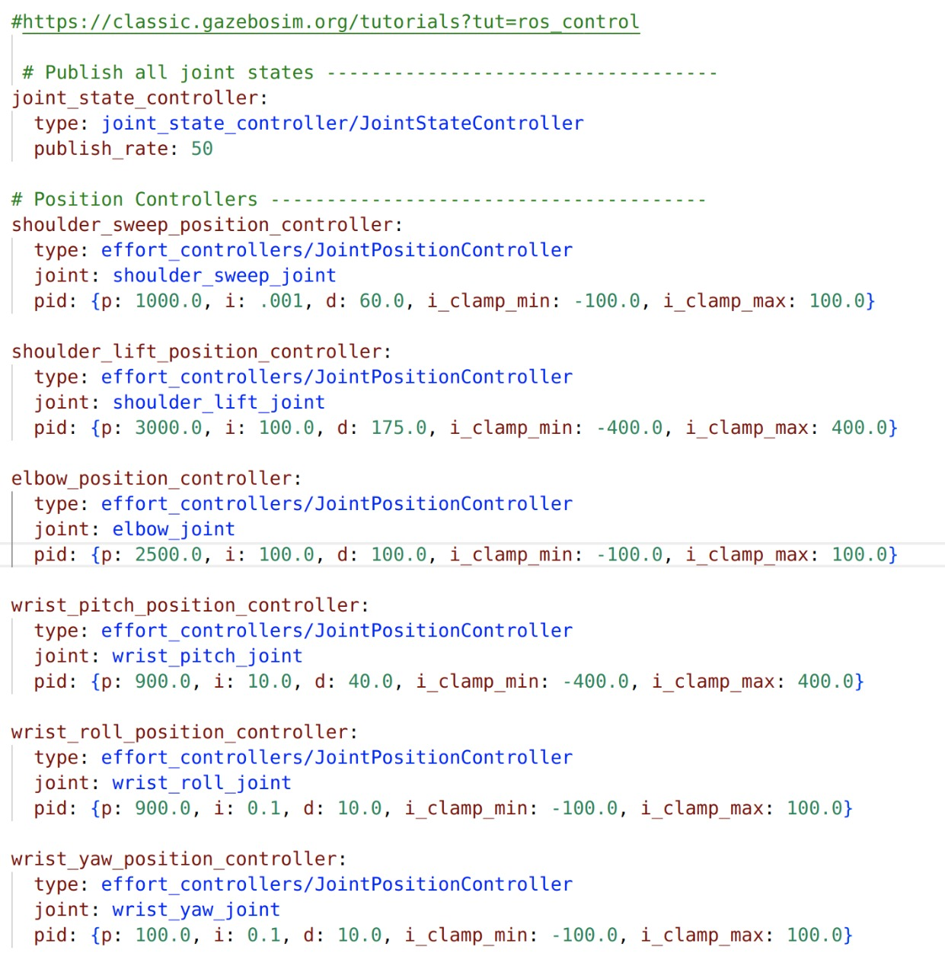
Control Method:
PID Control

Slide 12
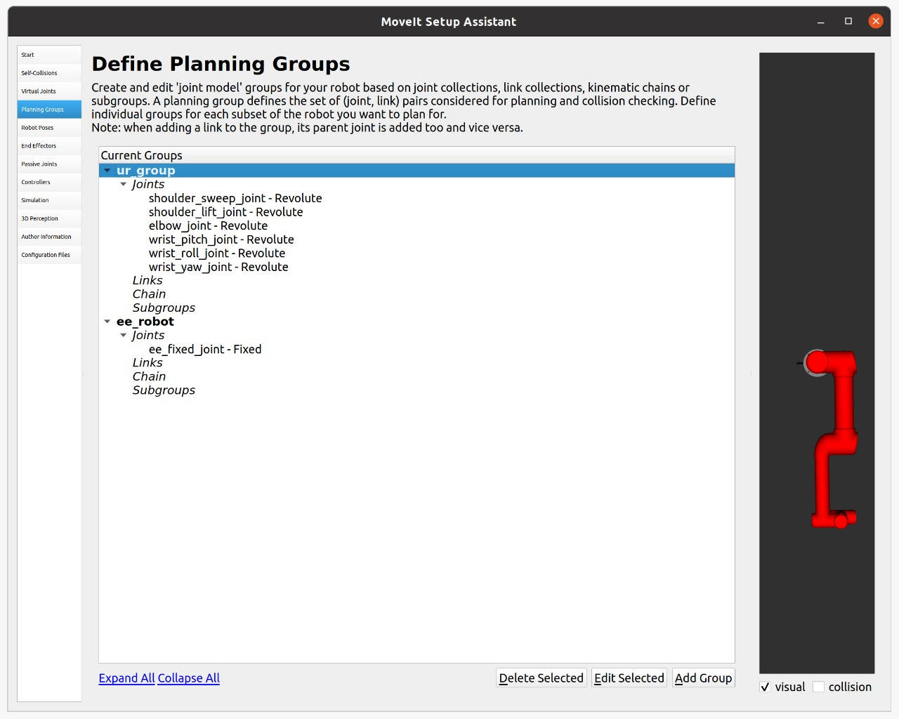
MoveIt – IK Planner Settings:

Slide 13
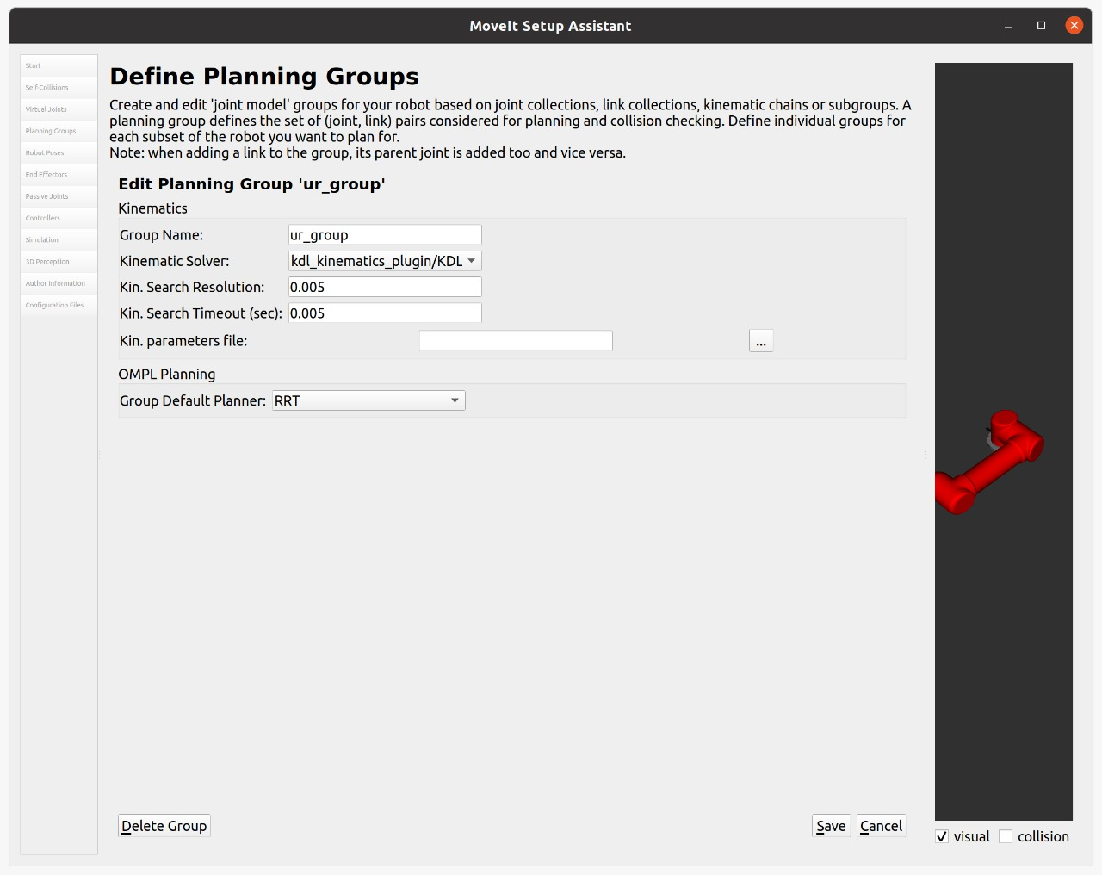
MoveIt – IK Planner Settings:

Slide 14
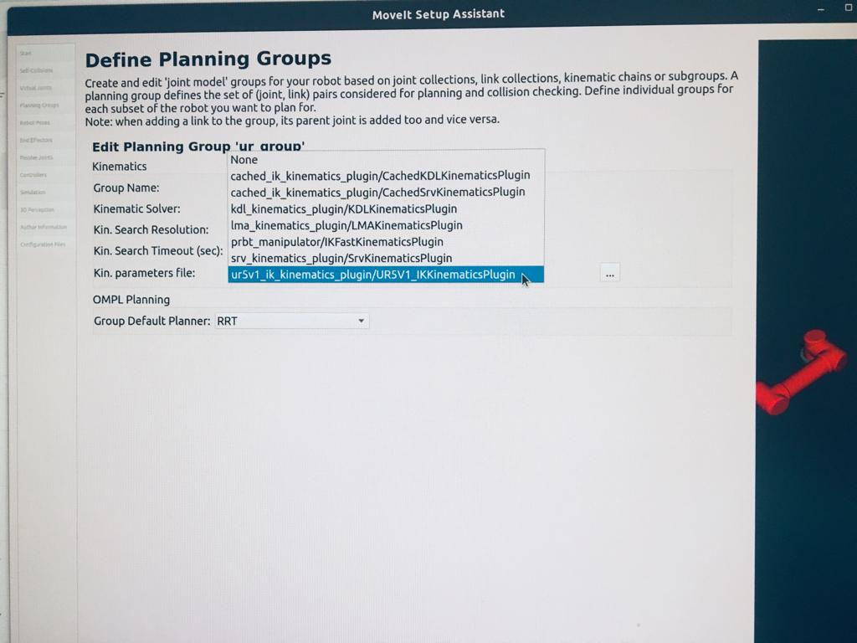
MoveIt – IK Planner Settings – Own IK plugin:

Slide 15
Assumptions:
Numerical Inverse Kinematics calculation requires an initial guess which can be solved using a planner in real world applications
Joint constraints are ignored in IK calculation
Environmental/workspace constraints will be handled by the planner.
Numerical Inverse Kinematics will converge in real time

Slide 16
Issues faced during the process:
Mass Inertia problems in the URDF generation from Solidworks
MoveIt planning group creation
Adding MoveIt transmission controllers to URDF
Using our own IK solver with MoveIt planner
IK logic adaptation from python code to C++ ROS plug-in
Solving IK using numerical methods
Damped Least square method takes more time to converge than direct Newton-Raphson method

Slide 17
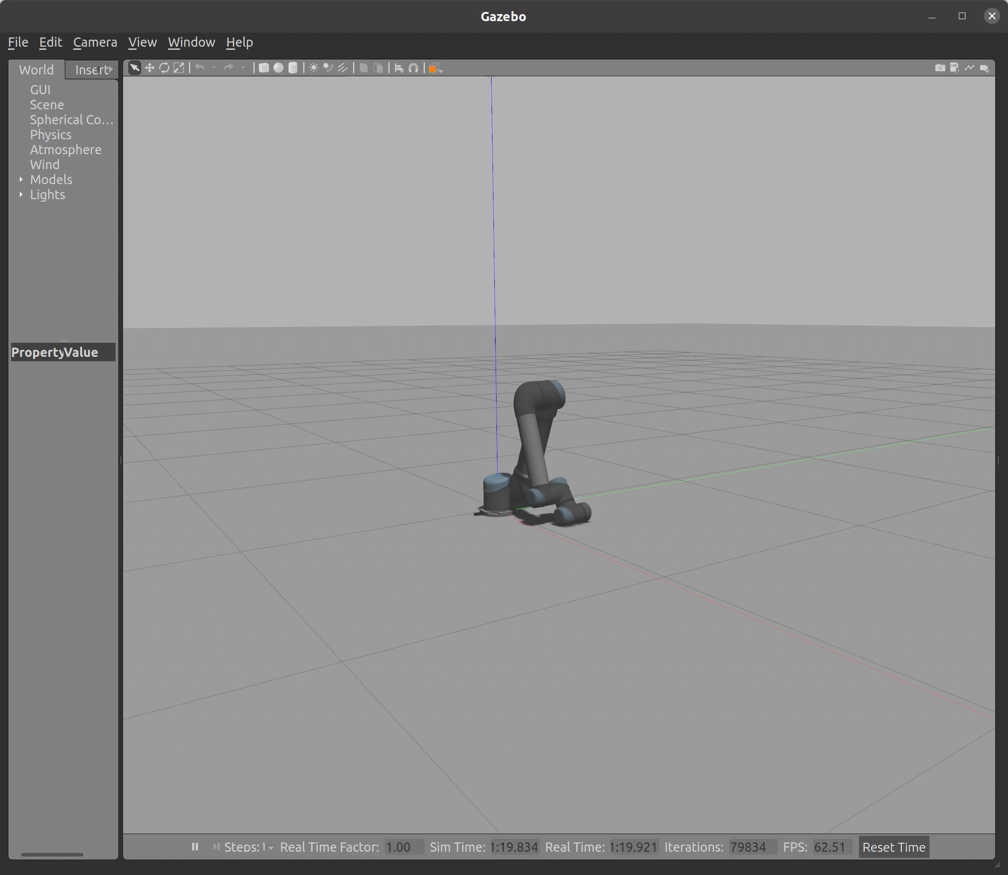
Gazebo & Rviz visualization

Slide 18
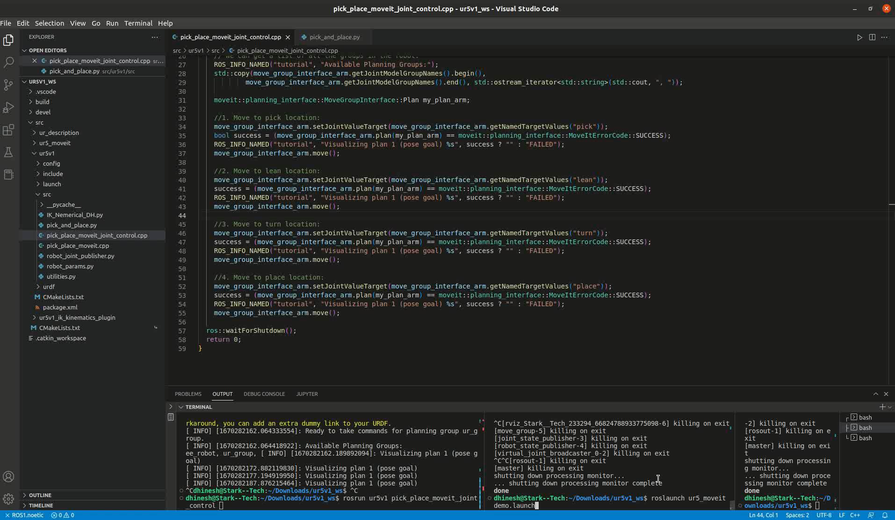
MoveIt joint control with solution generated by our IK

Slide 19
Lessons Learned:
Make sure to allow MoveIt setup assistant to overwrite URDF with transmission controllers
Make sure to turn on Gazebo simulation before publishing commands to controller topics
IK solver needs additional refinements and constraints validations to make it work with MoveIt planners

Slide 20
Conclusion
The main objective of the project is to implement an application based on basic pick and place operation using the Universal UR5 manipulator in the Robot Realization Laboratory.
The solidworks model of UR5 is taken and used for pick and place simulation
Created a ROS package and implemented FK, IK
The UR5 is implemented with MoveIt package in Rviz
Future scope:
The project will be further developed to work on actual hardware.
Own IK solver plugin to work with MoveIt planner

Slide 21
Individual Contribution
Tej Kiran:
Developed IK solver for UR5
Added controller
Added hardware interfaces
Written our own FK and IK algorithms based on D-H parameters
Implemented ‘Pick & Place’ workflow using the above functions and simulated the motion in Gazebo
Dhinesh:
Created a UR5 MoveIt package using MoveIt setup assistant
Used MoveIt Pick and Place API to move an abstract object in Rviz simulation environment
Explore the solidworks model for UR5
Arshad:
Created launch files, addition of hardware interfaces and controllers to URDF
Calculated DH parameters Table
Created joint angle publisher module
Test and validation of forward kinematics, inverse kinematics algorithms,
Test and validation of MoveIt ROS package in Rviz
Project proposal, report, and ppt

Slide 22
References:
https://docs.fetchrobotics.com/manipulation.html
https://gramaziokohler.github.io/compas_fab/0.21.0/examples/03_backends_ros/08_ros_create_moveit_package_from_custom_urdf.html
https://ros-planning.github.io/moveit_tutorials/doc/moveit_cpp/moveitcpp_tutorial.html#the-entire-code
https://ros-planning.github.io/moveit_tutorials/doc/pick_place/pick_place_tutorial.html#the-entire-cod
https://roboticscasual.com/ros-tutorial-how-to-create-a-moveit-config-for-the-ur5-and-a-gripper/
https://roboticscasual.com/ros-tutorial-pick-and-place-task-with-the-moveit-c-interface/
https://gramaziokohler.github.io/compas_fab/0.21.0/examples/03_backends_ros/08_ros_create_moveit_package_from_custom_urdf.html#3-8-3-add-virtual-joints

Slide 23
Thank you We would like to thank Dr. Reza Monfaredi & TAs – Pavan & Adarsh, for their valuable guidance in accomplishing this project.

